Slide 1

IT Ticket Analysis
Prakamya Verma

Slide 2

Problem Statement
This report presents a detailed examination of 97,499 resolved service tickets from a team of 50 agents over a five-year period (2016-2020). The analysis delves into key performance indicators—including ticket categorization, customer satisfaction, and resolution efficiency—to inform strategic planning and resource allocation. An accompanying interactive dashboard will be demonstrated to track agent performance and operational progress, culminating in actionable strategies for improving overall service desk effectiveness.

Slide 3

What is IT Ticket Management
The methodical process of managing all incoming IT-related problems and service requests inside a company is known as IT ticket management. From the beginning to the end, it entails gathering, classifying, ranking, allocating, monitoring, and finally addressing these requests. The main goals of this management system, which is usually made possible by specialized help desk or service desk software, are to expedite IT support operations, guarantee prompt and efficient problem solving, and eventually raise end-user satisfaction by offering well-organized and effective support.

Slide 4
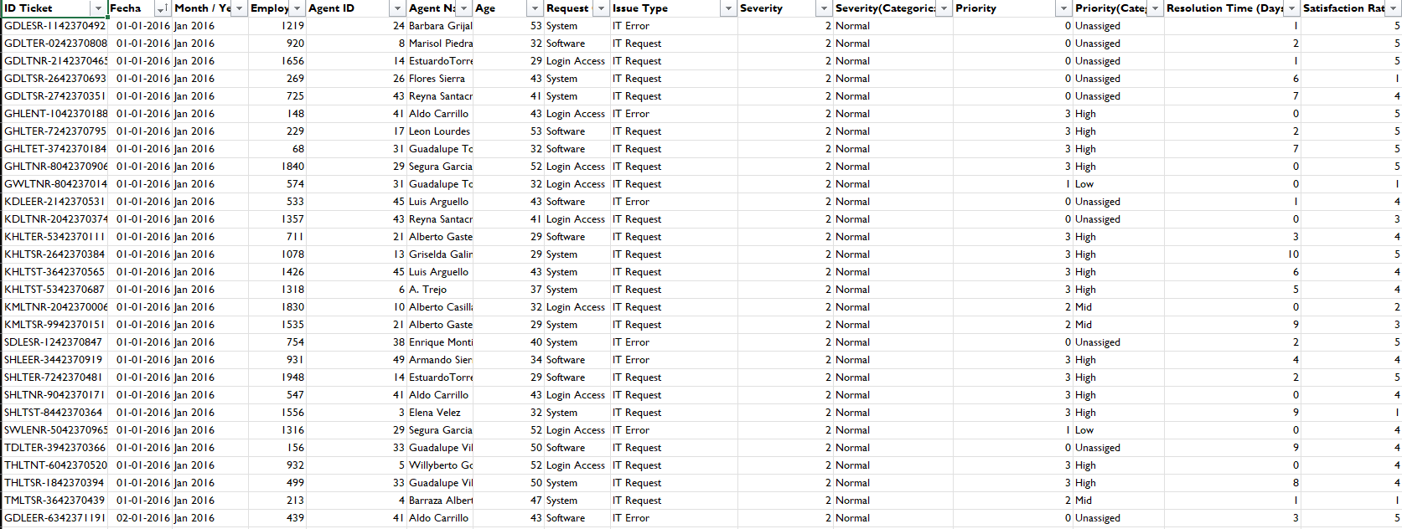
Tickets Sheet Data

Slide 5
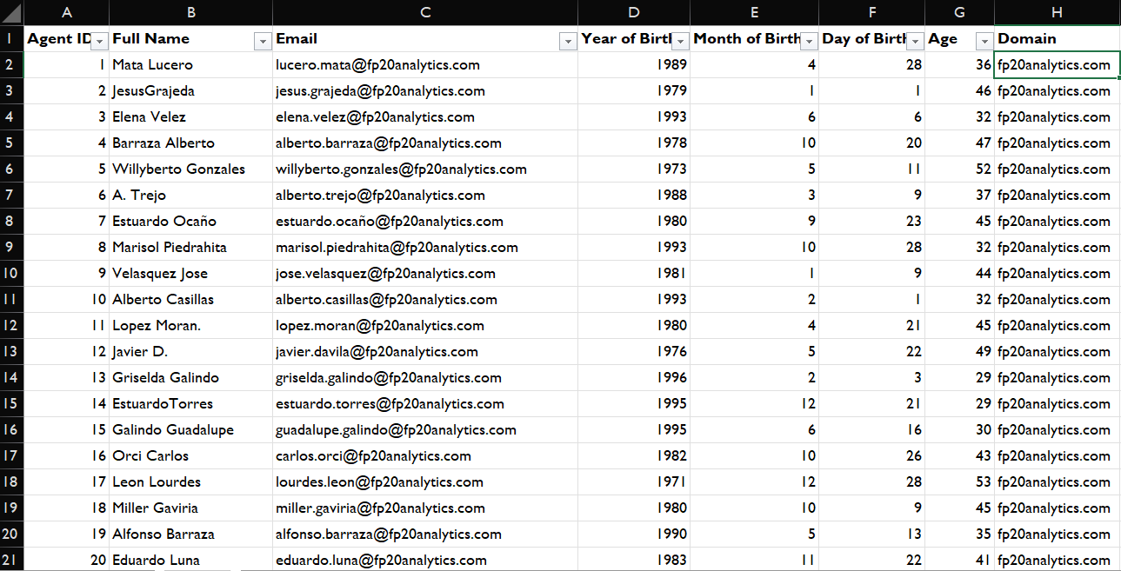
IT Agents Sheet Data

Slide 6
Data Attributes
IT Agents: Contains information about IT agents.
Agent ID: Unique identifier for the agent.
Full Name: Full name of the agent.
Email: Email address of the agent.
Year of Birth: Year the agent was born.
Month of Birth: Month the agent was born.
Day of Birth: Day the agent was born.
Tickets Sheet: Contains information about IT support tickets.
ID Ticket: Unique identifier for the ticket.
Fecha: Date of the ticket.
Employee ID: ID of the employee who raised the ticket.
Agent ID: ID of the agent assigned to the ticket.
Request Category: Category of the request (e.g., Login Access, System, Software).
Issue Type: Type of issue (e.g., IT Error, IT Request).
Severity: Severity of the issue.
Priority: Priority level of the issue.
Resolution Time (Days): Time taken to resolve the ticket.
Satisfaction Rate: Satisfaction rate provided by the employee (1-5 scale).

Slide 7
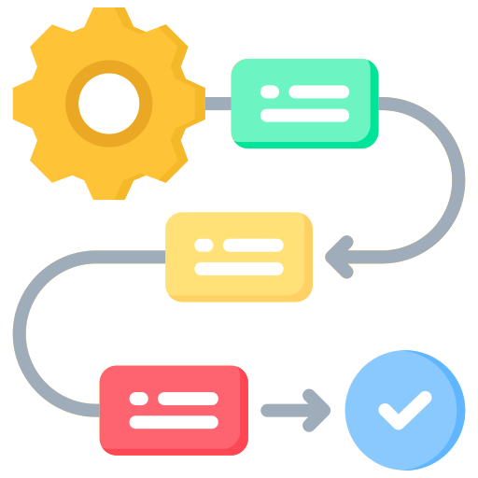
Methodology
1. Data Collection
Collected raw IT support data in Excel format.
Verified structure, data types, and column consistency.
2. Data Cleaning & Preparation
Checked for missing values — none found.
Used Find & Replace to correct spelling errors:
mayor → major
Unclasified → Unclassified
Unassiged → Unassigned
Separated combined Severity/Priority column using Text to Columns (Delimiter).
Created new fields: Severity Categorical and Priority Categorical.
Ensured consistent formatting of text, dates, and numeric fields.

Slide 8

Methodology
3. Data Analysis
Created Pivot Tables to summarize key metrics such as:
Tickets by Severity and Priority
Ticket Resolution Trends
Team Performance and Category-wise Analysis
4. Dashboard Development
Built an interactive Excel Dashboard
5. Insights & Reporting
Derived actionable insights on ticket resolution patterns.

Slide 9
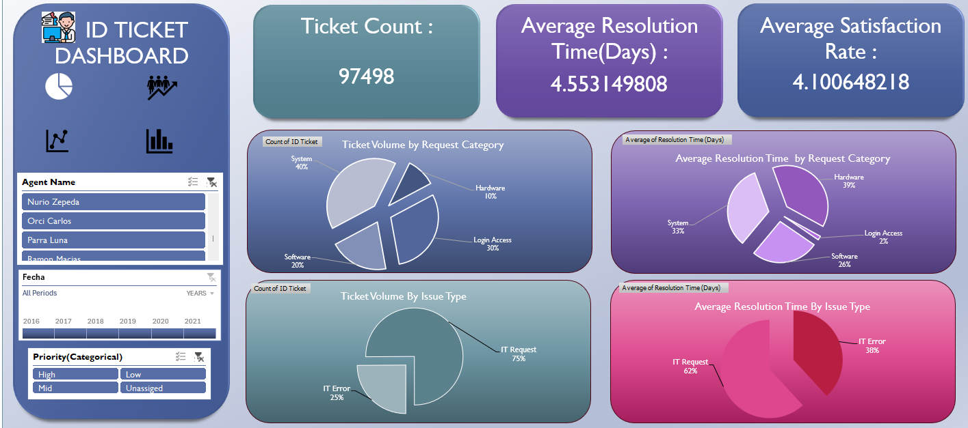
Dashboard Images

Slide 10
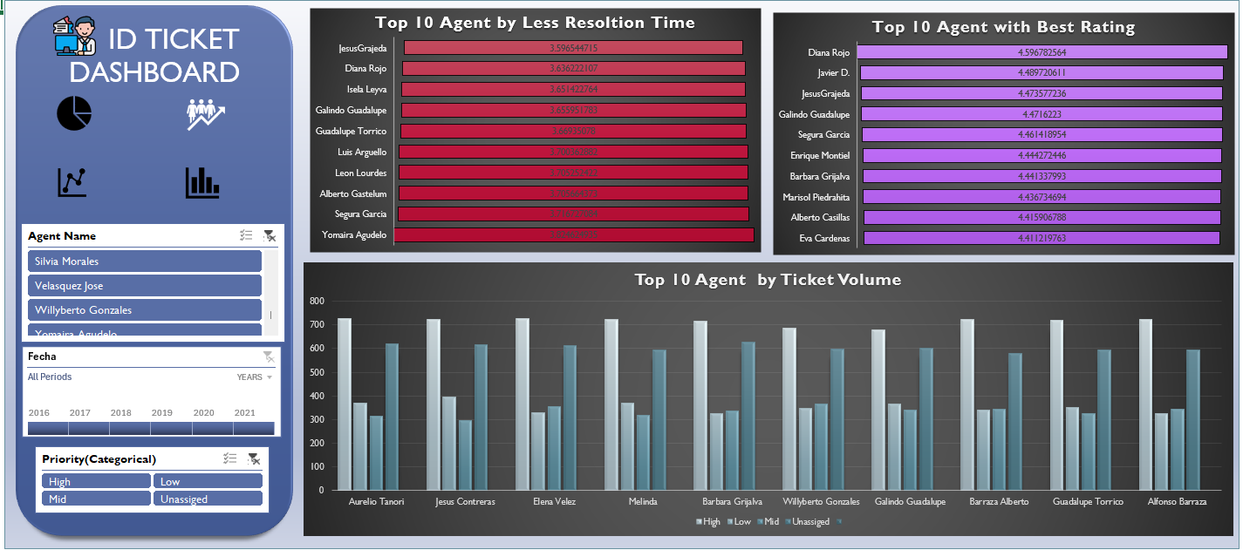
Dashboard Images

Slide 11
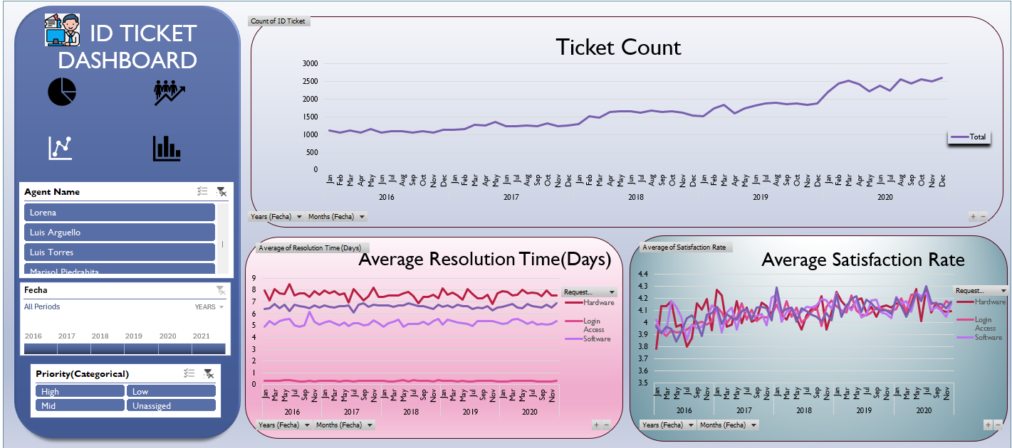
Dashboard Images

Slide 12
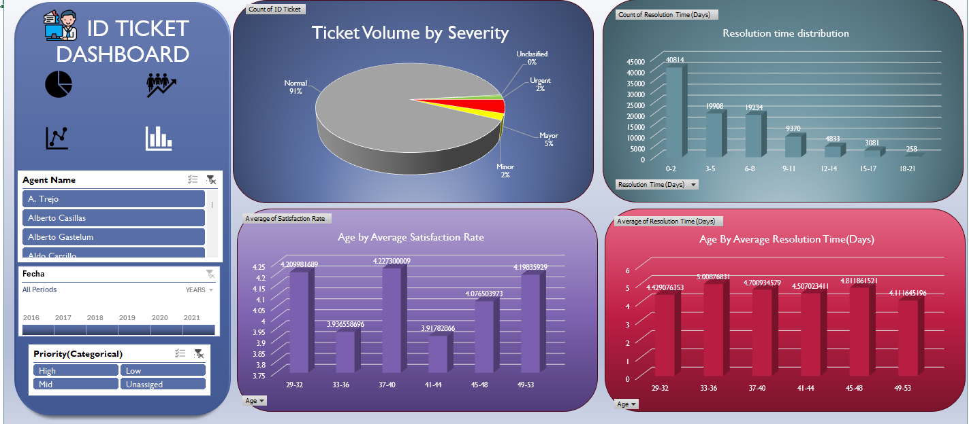
Dashboard Images

Slide 13

Insights
The average daily ticket volume is approximately 53.
Hardware has the lowest ticket volume, but the longest resolution time.
Aurelio Tanori Resolved Highest no of tickets i.e. 2027 overall

Slide 14
Request Category Charts
Hardware has the lowest ticket volume, but the longest resolution time.
System and Login Access categories account for the vast majority of IT requests.
System issues account for 40% of tickets, Login Access 30%, Software 20%, and Hardware 10%
Login Access has the lowest resolution time

Slide 15
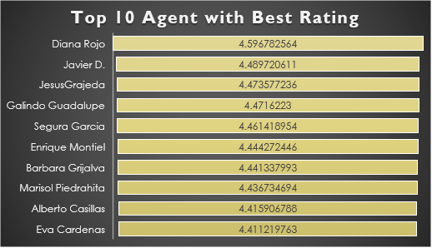
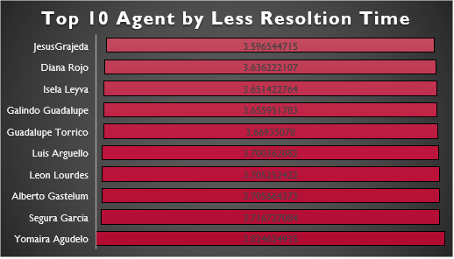
Top Agent by Performance
The correlation between resolution time and satisfaction (-0.0036) indicates almost no relationship, meaning faster resolutions don’t necessarily guarantee happier users.
Jesus Grajeda and Diana Rojo, These two are best agent when it comes to resolution time
Diana Rojo and Javier D., These two are best agent when it comes to Rating
Diana Rojo has best rating and very less resolution time

Slide 16
Ticket Count Over Time
Ticket volumes peaked sharply in 2020, but satisfaction rates remained stable or even improved, suggesting that process efficiency and agent performance improved over time. Peak months: Aug–Dec 2020 Stable months: Jan–Apr 2017–2018
Seasonal fluctuations exist with higher activity in Q1, mid-year, and year-end, but the overall trend is escalating demand.

Slide 17
Resolution time distribution
The majority of tickets (~42% or 40,814) are resolved within 0–2 days, indicating strong efficiency for quick-resolution issues. However, nearly 40% of tickets (3–8 days range) take moderately longer, suggesting room for process or automation improvements.
A smaller fraction (~10% of tickets) extend beyond 9 days, highlighting potential bottlenecks in complex issue categories that could benefit from targeted training or escalation optimization.

Slide 18
Recommendation
Agent Name
Alfonso Barraza
A. Trejo
Sandra Lujan
Nurio Zepeda
Elena Velez
Lorena
Guadalupe Villanueva
Lopez Moran.
Jesus Pacheco
Orci Carlos
Alfredo Barreras
Velasquez Jose
Aldo Carrillo
Luis Arguello
Parra Luna
Reyna Santacruz
Estuardo Ocaño
Flores Sierra
Agents Having Average Satisfaction Rate Less than 4.0
For agents with low satisfaction ratings, provide specialized training on customer service and communication skills.

Slide 19
Recommendation
Agent Name
Jesus Contreras
Estuardo Ocaño
Lorena
Ramon Macias
Mata Lucero
Nurio Zepeda
Elena Velez
Armando Sierra
Griselda Galindo
A. Trejo
Rosa Olguin
Barraza Alberto
Sandra Lujan
Alfonso Barraza
EstuardoTorres
Silvia Morales
Parra Luna
Guadalupe Villanueva
Agents Having Average Resolution time more than 4.8 Days
Agents with long resolution times, implement technical proficiency and process efficiency training, focusing on advanced troubleshooting, diagnostic tools, and knowledge base utilization.
Specifically train the 33-37 age group on System and Software troubleshooting.

Slide 20

Recommendation
Become Proactive:
Monitor ticket data for emerging patterns.
Prioritize and eliminate recurring issues.
Use predictive analytics to prevent future problems.
Champion Quality:
Value effective and durable resolutions.
Track FCR and CSAT metrics diligently.
Provide agents with advanced tools and knowledge.
Close the Feedback Loop:
Systematically collect post-resolution user input.
Utilize surveys and NPS for measurement.
Refine processes based on concrete user insights.
Support the Support Team:
Offer continuous training and development.
Recognize and reward achievements.
Ensure balanced workloads and a healthy work environment.
Streamline with Technology:
Implement chatbots for instant responses to FAQs.
Automate ticket routing and categorization.
Optimize workflows to boost overall efficiency.

Slide 21


